Slide 1


Listing multiples
Task A: Listing multiples
List the first five multiples of:
8
10
12
15
8, 16, 24, 32, 40
10, 20, 30, 40, 50
12, 24, 36, 48, 60
15, 30, 45, 60, 75
2) Alex says
30 is a multiple of 4 because 4 ✕ 7.5 = 30
Is Alex correct? Explain your answer
A multiple is the product of two integers
3) Jacob started listing the first multiples of some numbers. He then spilled ink all over his work.
Find the multiples Jacob was working out and the missing numbers.
Multiples of 111 :
222
333
111, , , 444, 555, …
, 46, , 92, 115, …
324, , , , 1620, …
, , , , 4225, …
23
138,
b) Multiples of :
23
69
c) Multiples of 324 :
972
1296
648
845
d) Multiples of :
1690
845
2535
3380

Slide 2

Listing multiples
Task B: Using listing to find common multiples
Find all the common multiples of 7 and 5 which are less than 100.
Find all the common multiples of 5, 8 and 10 which are less than 100.
Common multiples: 35 and 70
Common multiples: 40, 80
3) Using the numbers, fill in the missing gaps. You can only use each number once.
12
6
12
is a common multiple of and
is a common multiple of and
is a common multiple of and
50
5
10
27
27
9

Slide 3



Listing multiples
Task B: Using listing to find common multiples
4) A path is made up from 100 steps, numbered 1 to 100.
Robot A steps on every 8th step.
Robot B steps on every 3rd step.
Robot C steps on every 6th step.
a) Which numbered steps will all three robots have stepped on?
24, 48 and 72
b) Robot D steps on every 2nd step. Will this change your answer to part a? Explain why.
No because multiples of 2 are also common multiples of 8 and 6 so it will make no difference.

Slide 4
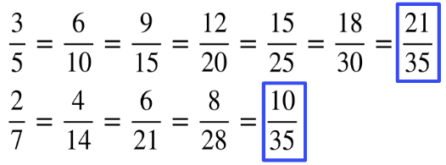
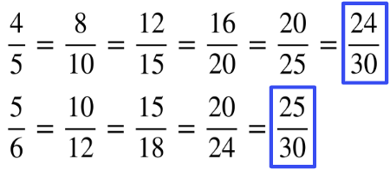

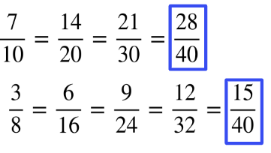
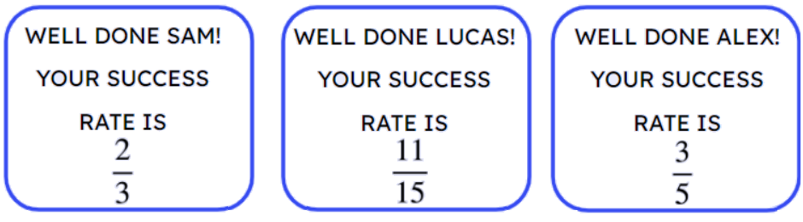

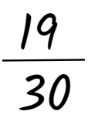
Listing multiples
Task C: Using common multiples to compare fractions
Using common multiples to compare fractions, identify the largest fraction. You must show your working out.
and
b) and
c) and
2) Three students have the following success rates on a game.
Who is the best player? You must show your working out.
Lucas
State a fractional success rate in between Sam’s and Alex’s.
Mathematics in Education and Industry
v2.2

